Slide 1
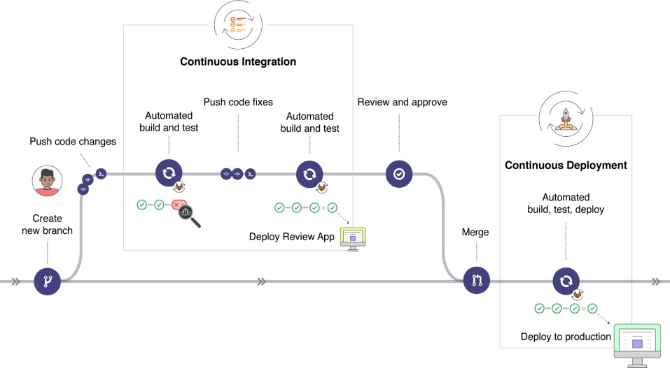
CI/CD with GitLab
Slide source: Dr Soly

Slide 2


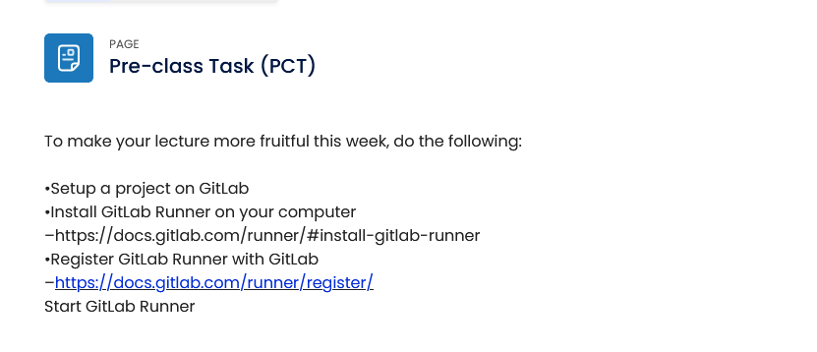
CI/CD with GitLab
Self-directed Activity (SDA)
Slide source: Dr Soly

Slide 3
Classwork: CI/CD with GitLab
Self-directed Activity (SDA)
Create a CI/CD pipeline on GitLab
  Create/add a file called “.gitlab-ci.yml” in the root folder of your project.
  This YAML file defines the structure and order of the CI/CD pineline and decides:
    What will be executed using GitLab Runner
    What to do when some specific conditions are satisfied (e.g. when a process succeeds or fails).
    See https://docs.gitlab.com/ee/ci/yaml/ for more details
Slide source: Dr Soly

Slide 4
CI/CD with GitLab
A live demo of how to set up and run CI/CD with GitLab
  https://www.youtube.com/watch?v=jUiKi6FWYrg&list=PL hW3qG5bs-L8YSnCiyQ-jD8XfHC2W1NL_&index=8
GitLab CI/CD Examples for different types of applications written in different programing languages
  https://docs.gitlab.com/ee/ci/examples/
  Dev Ops https://www.youtube.com/watch?v=UbtB4sMaaNM
Slide source: Dr Soly

